Slide 1
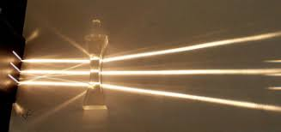
Daily Review
Describing Images Formed With Lenses
Identify the type of lens used. Describe what the lens does to light rays passing through it: converges or diverges
This is a concave lens.
The lens is diverging the light rays so they cover a wider area.

Slide 2
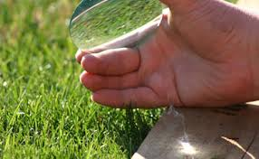
Daily Review
Describing Images Formed With Lenses
Identify the type of lens used. Describe what the lens does to light rays passing through it: converges or diverges
The lens in is a convex lens.
The lens is converging the light rays to a single point, causing the paper to burn.
.

Slide 3
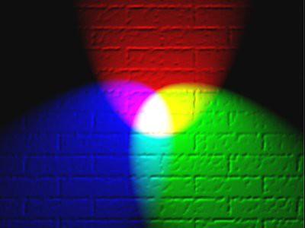
Daily Review
Colours of Light
There are six basic colours of light.
Three of these colours are called primary colours.
When two primary colours are mixed, they form secondary colours.
List the three primary colours of light.
Why is yellow considered to be a secondary light colour?
Magenta
Red
Yellow
White
Red
Blue
Green
Cyan
Blue
Green

Slide 4
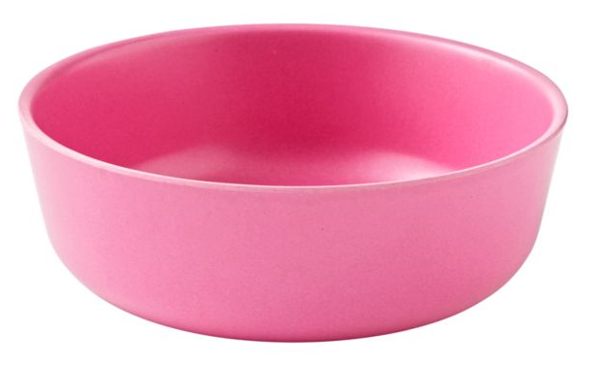
Daily Review
Explaining Coloured Objects
State whether the object is opaque or transparent. State the colour the object appears. Describe which colours reflected/pass through the object and which are absorbed by the object.
The ______ is _______and appears _______. ________ light is reflected / passing through. ______ light is absorbed.
Magenta
Red
Yellow
Blue
Green
Cyan

Slide 5
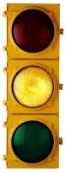
Daily Review
Explaining Coloured Objects
State whether the object is opaque or transparent. State the colour the object appears. Describe which colours reflected/pass through the object and which are absorbed by the object.
The ______ is _______and appears _______. ________ light is reflected / passing through. ______ light is absorbed.
Magenta
Red
Yellow
Blue
Green
Cyan

Slide 6
The Eye Year 9 Physics

Slide 7
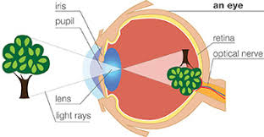
Learning Objectives
CFU
What are we going to learn?
Describe how the eye enables us to see.
Identify and describe the function of the different parts of the eye.
Activate Prior Knowledge
The eye contains a convex lens.
Think, pair, share: What does this type of lens do to light rays passing through it?

Slide 8
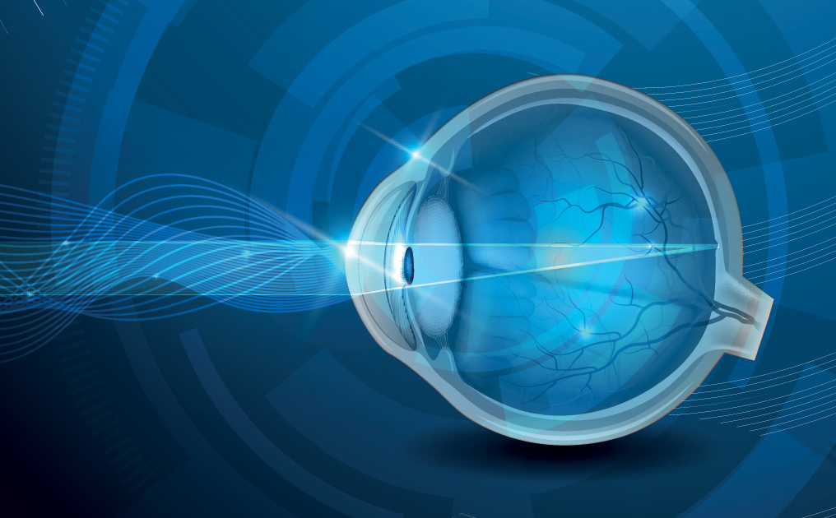
Concept Development
CFU 1
What sense does the eye provide for us?
The Eye
The eye is one of the sensory organs.
Photoreceptors in the eye detect the light that is reflected off objects around us.
Messages are sent to the brain, allowing us to see what is around us.
CFU 2
What does a photoreceptor detect?

Slide 9
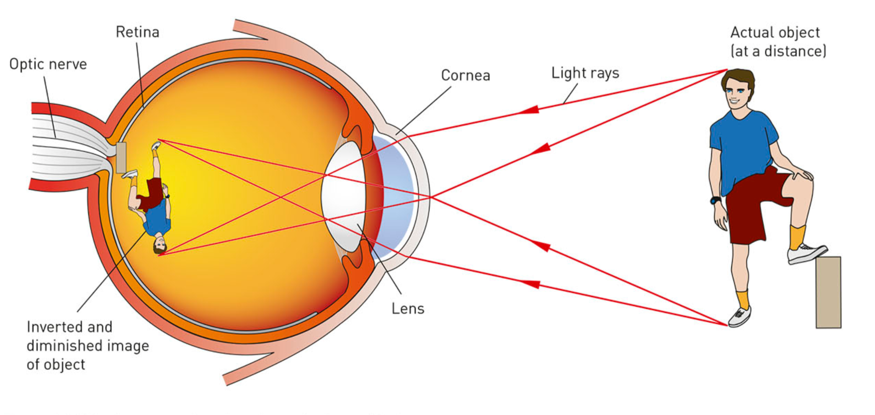
Concept Development
CFU 1
What is the function of the lens in the eye?
How the Eye Functions
Light enters the eye through the cornea and pupil.
A lens focuses the light onto the back of the eye.
Photoreceptors on the back of the eye detect the light.
A message is sent to the brain, which then forms a picture.
CFU 2
What does a photoreceptor detect?
CFU 3
Draw a simple flow diagram to show how the eye functions.

Slide 10
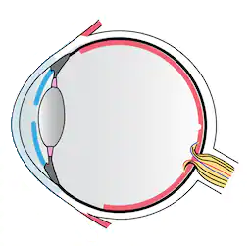
Skill Development/Guided Practice
Structure of the Eye
Collect a paper copy of the eye worksheet, or download it from Connect.
Use the information on the following slides to complete it the first page.

Slide 11
Skill Development/Guided Practice
CFU 1
What does the cornea do to light rays?
Structure of the Eye – Letting light into the eye
The cornea is the curved part at the front of the eye. It bends light rays as they enter the eye and provides protection.
The coloured part is called the iris. It controls how much light enters the eye, by contracting (closing) and dilating (opening).
The pupil is a circular opening in the iris that allows light to enter the eye.
CFU 2
How does the iris control light entering the eye?
Iris
Pupil
Cornea

Slide 12
Skill Development/Guided Practice
CFU 1
What is the function of the lens?
Structure of the Eye – Focusing the light
The lens bends light rays to form a focused image.
The shape of the lens is controlled by the ciliary muscles. The muscles pull on the lens to change its shape so it can focus on both near and far objects.
CFU 2
How do the ciliary muscles change the shape of the lens?
Ciliary muscles
Lens

Slide 13
Skill Development/Guided Practice
CFU 1
Where are the photoreceptors found?
Structure of the Eye – Detecting an image
The lens forms an image on the retina. The retina contains photoreceptors, called rods and cones, that convert light into electrical signals.
The optic nerve carries electrical messages to the brain.
Behind the retina is the choroid. This is a dark layer of tissue that absorbs light and provides nutrients to the retina.
CFU 2
What is the function of the optic nerve?
Retina
Choroid
Optic nerve

Slide 14
Skill Development/Guided Practice
CFU 1
What does the sclera provide to the eye?
Structure of the Eye – Providing support
The sclera is the tough, white outer layer of the eyeball.
Between the cornea and the lens is a watery fluid called the aqueous humour. It provides nutrients to the lens and cornea.
The vitreous humour is a jelly-like substance that fills the eyeball and helps it keep its shape.
CFU 2
How are the aqueous and vitreous humours different?
Sclera
Aqueous humour
Vitreous humour

Slide 15
Relevance
Knowing the structure of the eye will help you understand how we are able to see the world around us.

Slide 16
Skill Closure
What type of receptors are in the eye?
Skill Closure
Briefly describe how the eye allows us to see.
Skill Closure
Match each part of the eye to its function.
Pupil A Jelly-like substance that give the eye shape
Optic nerve B Focus the light
Lens C Contains photoreceptors called rods and cones
Vitreous humour D Allows light to enter the eye
Sclera E Carries electrical messages to the brain
Retina F Tough, white part of the eye

Slide 17
Independent Practice
Complete the rest of the questions on the eye worksheet.

